Slide 1
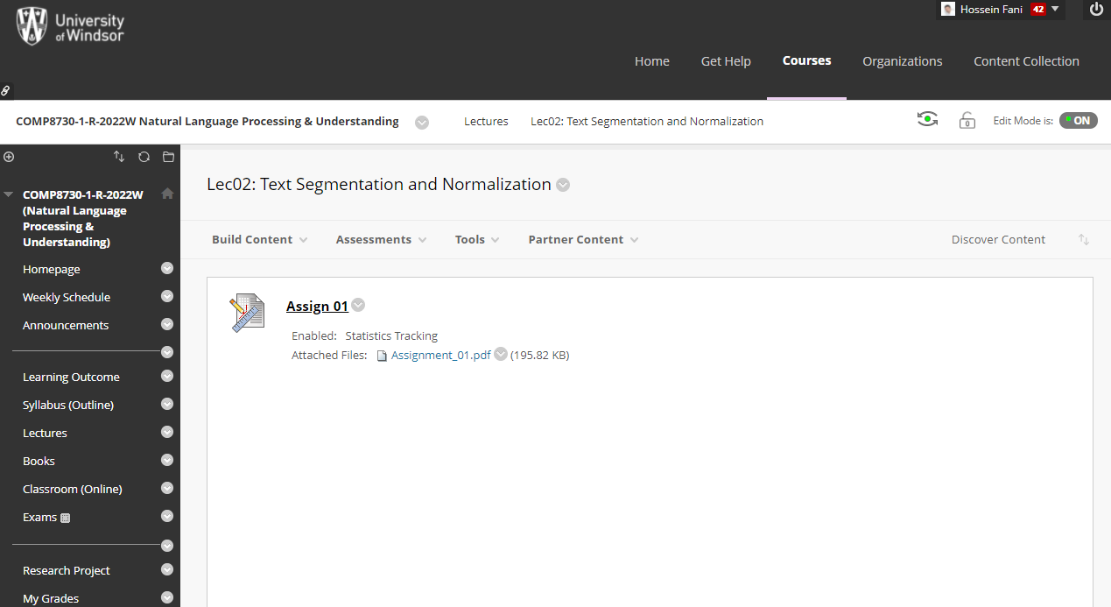

Slide 2
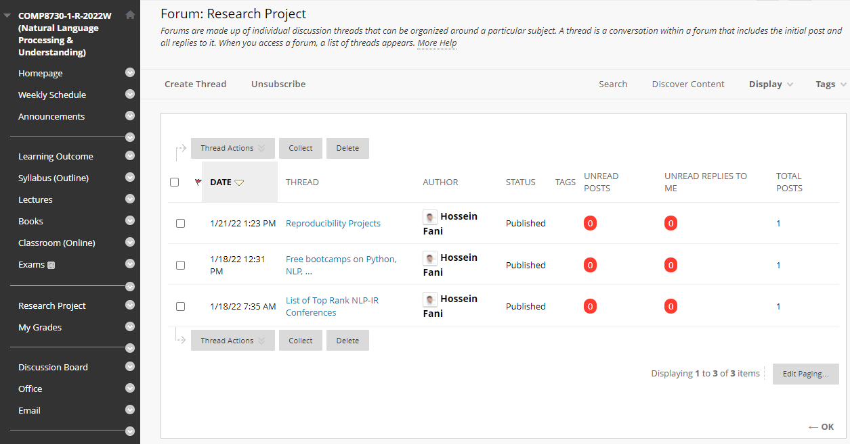

Slide 3
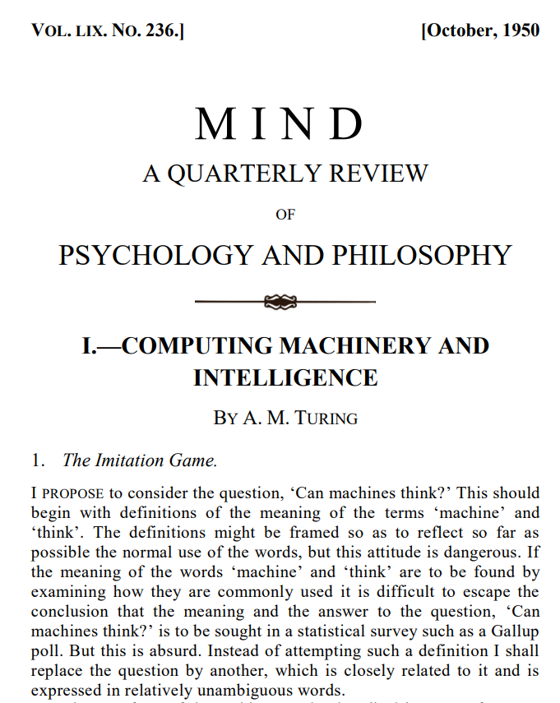

The Turing Test
by Alan Turing in 1950
Player C, the interrogator, is given the task of trying to determine which player – A or B – is a computer and which is a human. The interrogator is limited to using the responses to written questions to make the determination.
Notes:
,^{[2]} is a test of a machine's ability to exhibit intelligent behaviour equivalent to, or indistinguishable from, that of a human.
Turing proposed that a human evaluator would judge natural language conversations between a human and a machine designed to generate human-like responses.

Slide 4
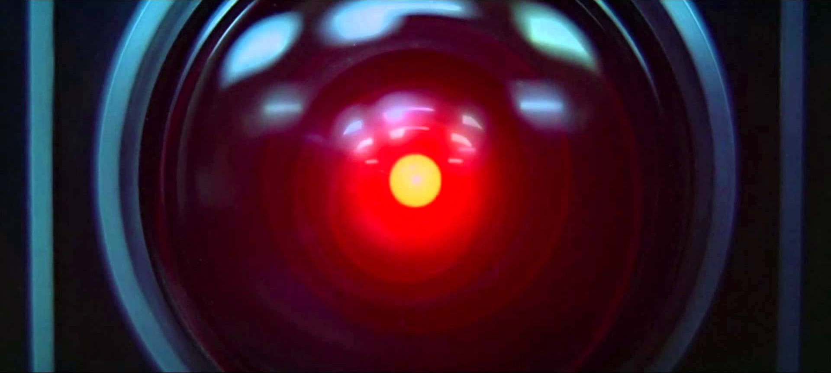
2001: A Space Odyssey (1968), Stanley Kubrick and Arthur C. Clarke
- A Conversation with HAL! https://www.youtube.com/watch?v=r13I-TuDcWI
- HAL Reads Lips! https://www.youtube.com/watch?v=XDO8OYnmkNY
– HAL: I'm Sorry, Dave! https://www.youtube.com/watch?v=Wy4EfdnMZ5g
Notes:
conversational agents or dialogue systems:
Language input (automatic speech recognition and natural language understanding)
Language output (dialogue and response planning and speech synthesis).
Applications:
Machine translation
Web-based question answering → generalization of simple Web search
Definition questions: What does “divergent” mean?
Simple factoid questions like dates and locations: What year was Abraham Lincoln born?
Inference (drawing conclusions based on known facts), or synthesizing and summarizing information from multiple sources or Web pages
Information Extraction (IE)
Word Sense Disambiguation (WSD)

Slide 5

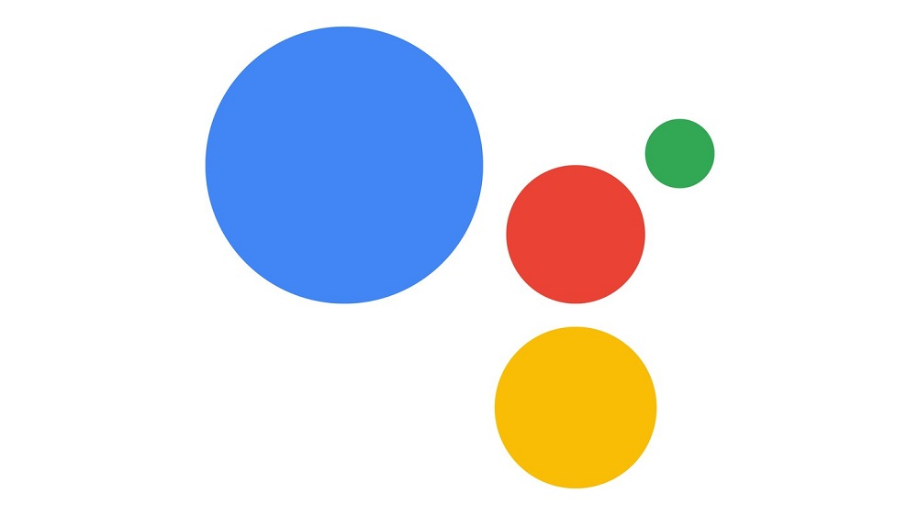
Google Duplex: A.I. Assistant Calls Local Businesses To Make Appointments
https://www.youtube.com/watch?v=D5VN56jQMWM
Notes:
Sundar Pichai
Google’s CEO

Slide 6
Research Priorities for Artificial Intelligence
The capacity for language is one of the central features of human intelligence and is therefore a prerequisite for artificial intelligence.
Despite its many practical applications, language is perhaps number 300 in the priority list for AI research. It would be a great achievement if AI could attain the capabilities of an orangutan, which do not include language!
- Yann LeCun (computer vision researcher)
Russell, Stuart, Daniel Dewey, and Max Tegmark. "Research priorities for robust and beneficial artificial intelligence." Ai Magazine 36.4 (2015): 105-114.

Slide 7
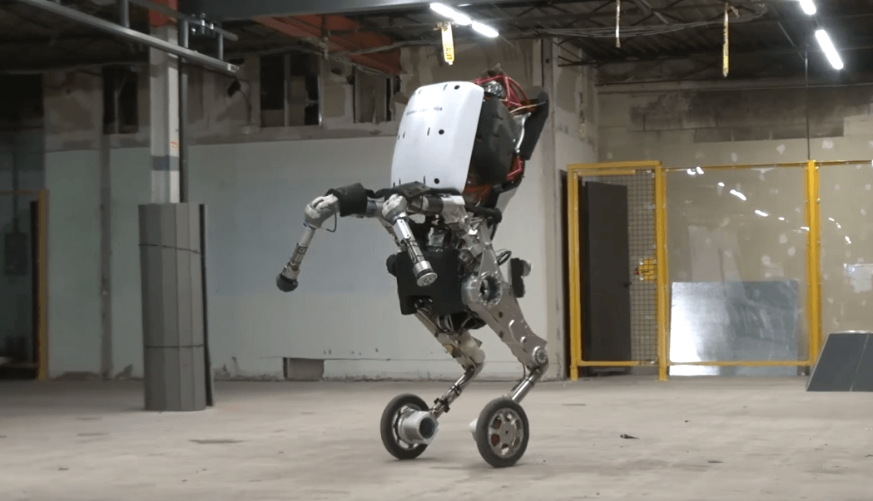
Handle: Boston Dynamics' newest design. Jumps 4 feet in the air and zips around at 9 miles per hour. https://www.youtube.com/watch?v=7h8mX9ZMs7g

Slide 8
stateof.ai
#stateofai
State of AI Report
October 12, 2021
Nathan Benaich
Ian Hogarth

Slide 9
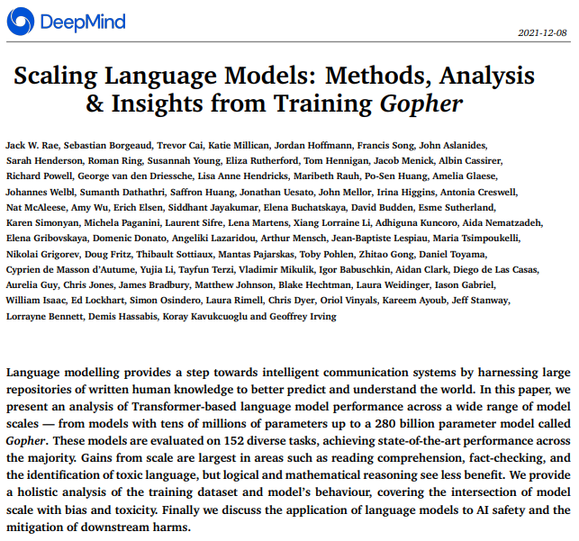
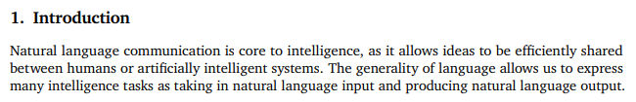

Slide 10
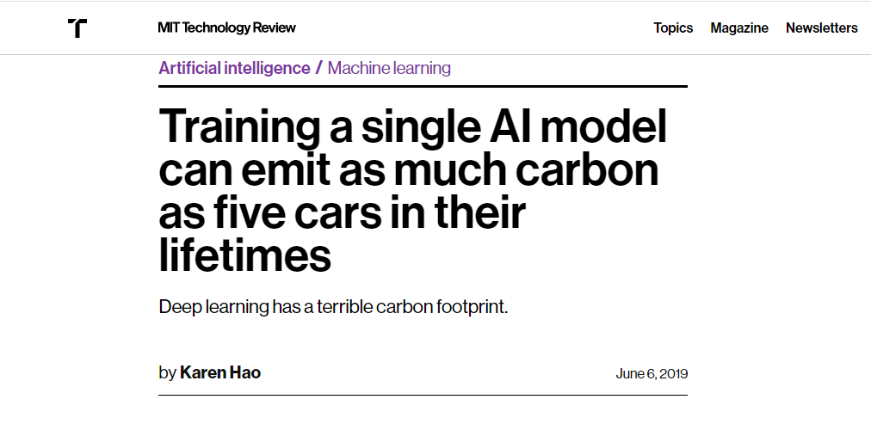
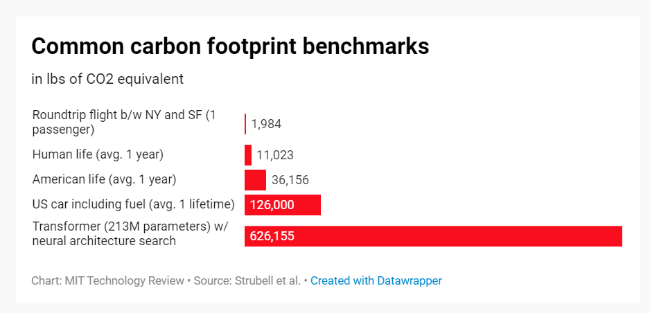
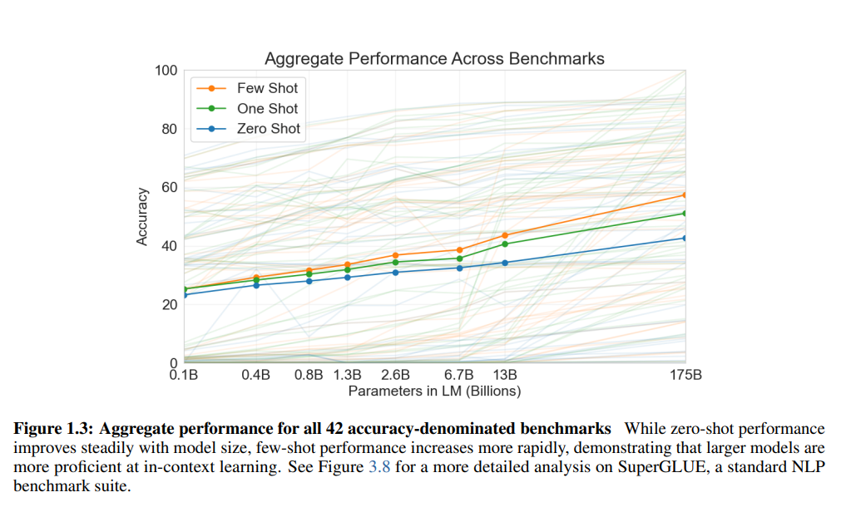

Slide 11
Natural Language Communication
Natural Language Understanding
Natural Language Processing
Speech, Text, Emotion, …

Slide 12
Computer Science
Research
Project
Statistical
Learning
Mathematic
Theory
Background
This Course
Approach
Structural
Search
Linguistics
Assignment
Task
NLP is AI-hard (why?)

Slide 13
Pipeline of Understanding
Phonetics and Phonology, Morphology, Syntax, Semantics, Pragmatics, Discourse
Ambiguity
I made her duck
Language is Situated
Rationale, Code Switch, Genre, Time, Place, Dialect, Author
Computational Complexity
Discrete, Compositional, Power-law distribution

Slide 14

Lec01A
11:30am-12:45pm
Text Segmentation

Slide 15
Lec01B
01:00pm-02:20pm
Text Normalization

Slide 16
Natural Language Processing
Phonetics and Phonology, Morphology, Syntax, Semantics, Pragmatics, Discourse

Slide 17
Phonetics and Phonology
knowledge about linguistic sounds
how words are pronounced in terms of sequences of sounds
how each of these sounds is realized acoustically

Slide 18
Phonetics and Phonology
Speech Recognition (SR)
recognize words from an audio signal like in assistants: Alexa, Homepod
Speech Synthesis (Synthesizers)
generate an audio signal from a sequence of words like in Automatic Announcement
Automatic Answering Machine

Slide 19
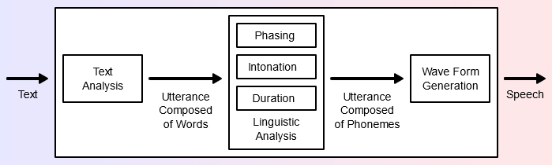
Phonetics and Phonology
Text-To-Speech System (TTS)
Phone [fəʊn]→Diphones [fə], [əʊ], [ʊn]→much more natural than combining simple phones

Slide 20
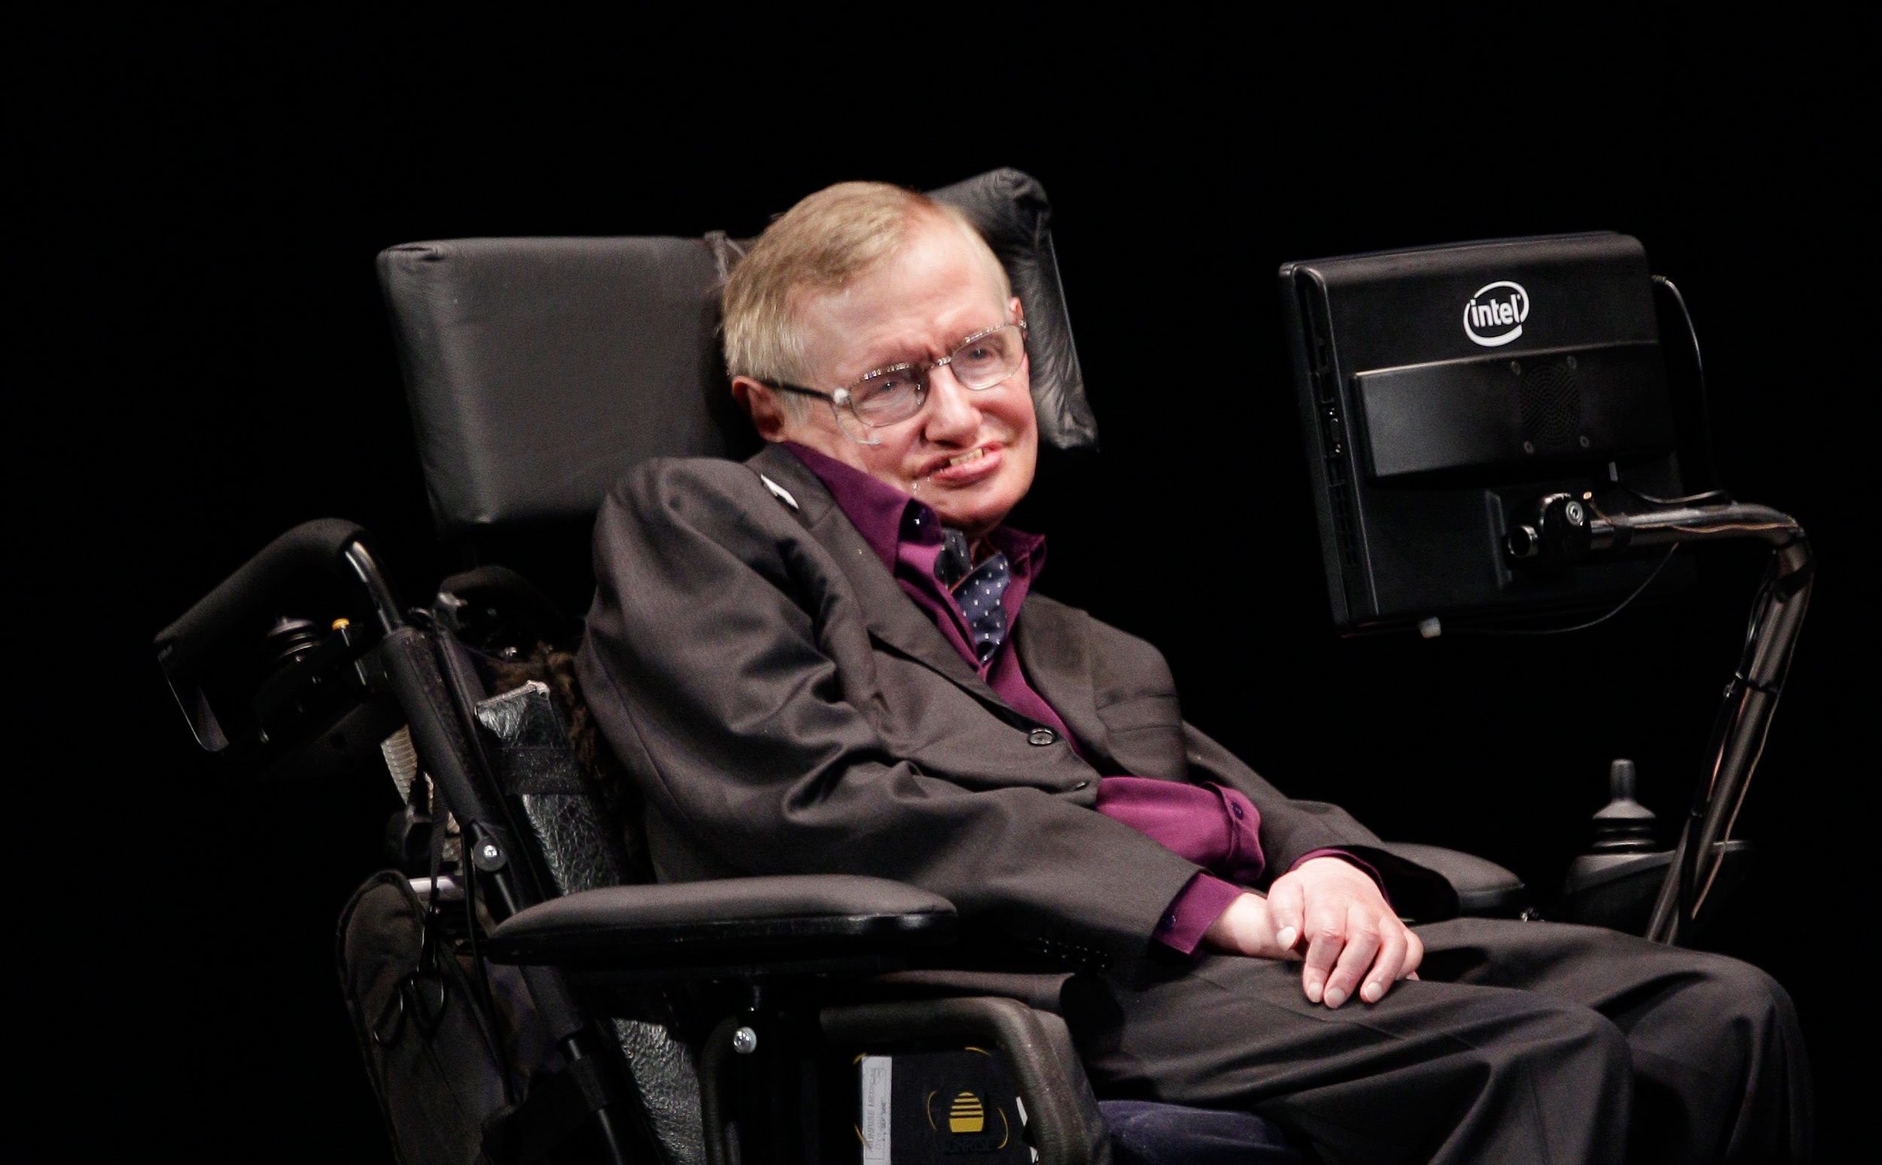
Stephen Hawking talks about technology and ACAT (Assistive Context Aware Tool-kit)
https://www.youtube.com/watch?v=TXY8IKFeKZs
https://01.org/acat/
image: Ted S. Warren/AP

Slide 21
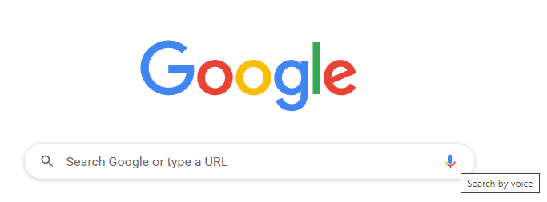

Slide 22
Natural Language Processing
Phonetics and Phonology, Morphology, Syntax, Semantics, Pragmatics, Discourse

Slide 23
Morphology
knowledge of the meaningful components of words
producing and recognizing variations of individual words
the way words break down into component parts that carry different meanings
study of words, how they are formed, their relationships in the same language

Slide 24
Morphology
Lexeme
- Also known as Lemma or citation form
- Refer to a same entity or concept
- Change is called Inflection
- Inflection Rules:
Singular vs. Plural: index → indexes, indices
Contractions: cannot → can’t
Tenses: do → did, done, does
Wordforms
- Form new lexemes
- Refer to different entities or concepts or …
- Wordformation Rules:
Compounding: [Dog][catch][er], [Dish][wash][er]
Lemma(Dishwashers) = Dishwasher
Lemma(Dishwashers) ≠ Dish ≠ Wash

Slide 25
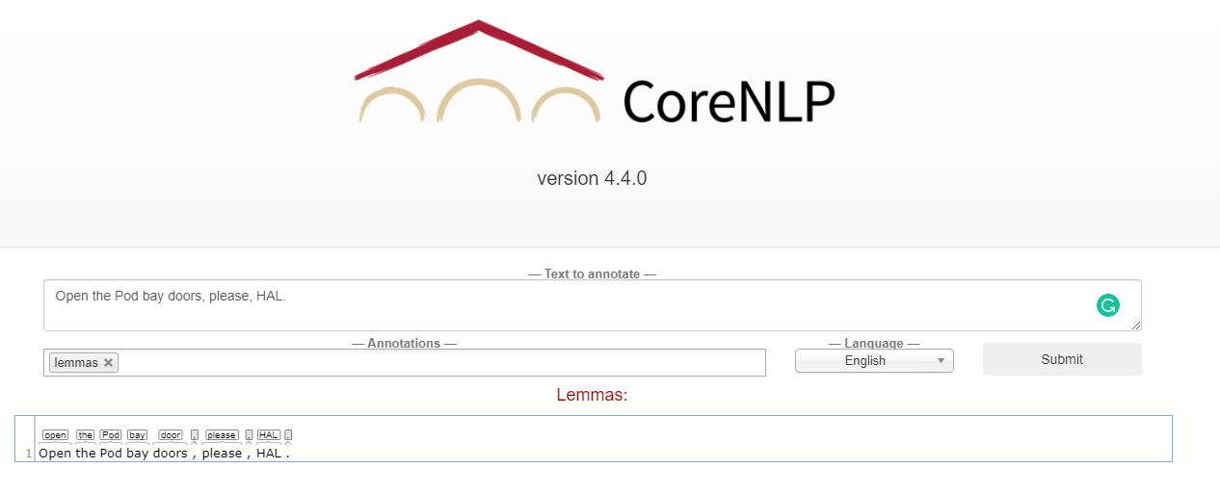
Lemmatizer

Slide 26
Natural Language Processing
Phonetics and Phonology, Morphology, Syntax, Semantics, Pragmatics, Discourse

Slide 27
Syntax
knowledge of the structural relationships between words
knowledge needed to stream (order) words
moving beyond individual words
HAL: I’m I do, sorry that afraid Dave I’m can’t. ↔ I’m sorry Dave, I’m afraid can’t.

Slide 28
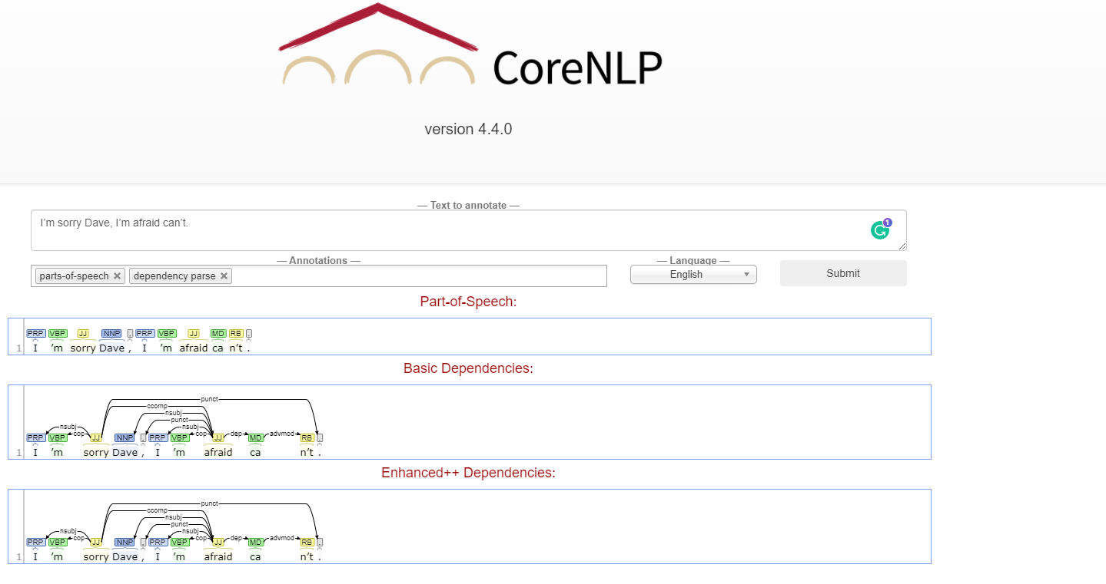
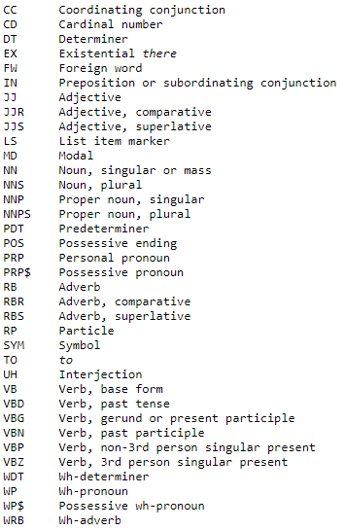
Pos Tagger
Parser
https://cs.nyu.edu/~grishman/jet/guide/PennPOS.html
Notes:
https://cs.nyu.edu/~grishman/jet/guide/PennPOS.html

Slide 29
Natural Language Processing
Phonetics and Phonology, Morphology, Syntax, Semantics, Pragmatics, Discourse

Slide 30
Semantics
knowledge of meaning
Lexical
The meaning of the words
cat → a small domesticated carnivorous mammal …
Polysemy: one word with two or more distinct meanings
polyseme is a word or phrase with multiple meanings
afraid → Scared
afraid → Politely apologetic
Compositional
The meaning of the sentences
I’m afraid of being sorry
sorry, I’m afraid I can’t

Slide 31
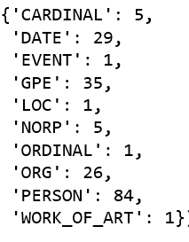
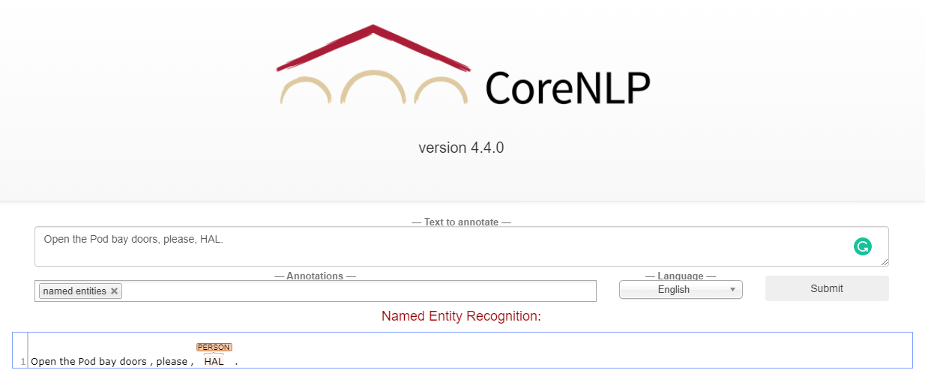
Named Entity Annotators

Slide 32
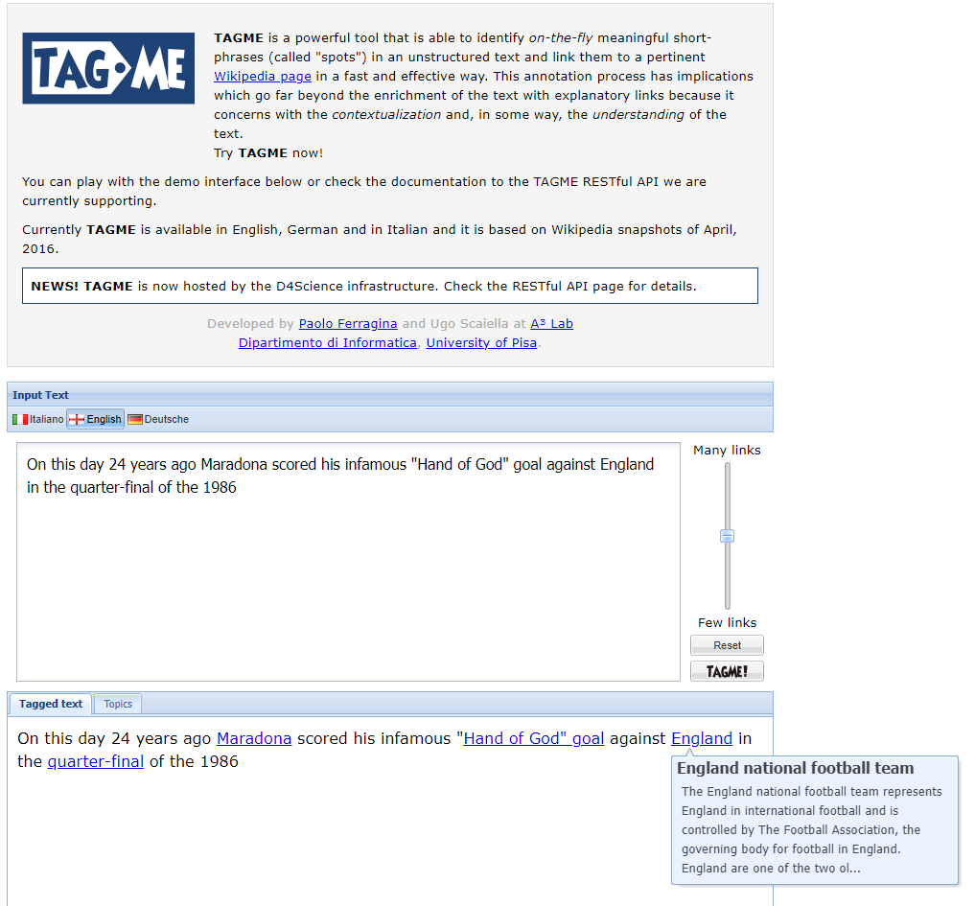
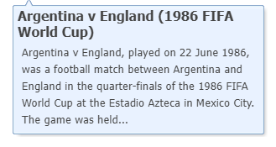
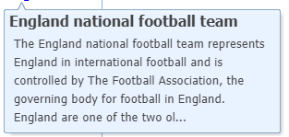
Semantic Annotators

Slide 33
Natural Language Processing
Phonetics and Phonology, Morphology, Syntax, Semantics, Pragmatics, Discourse

Slide 34
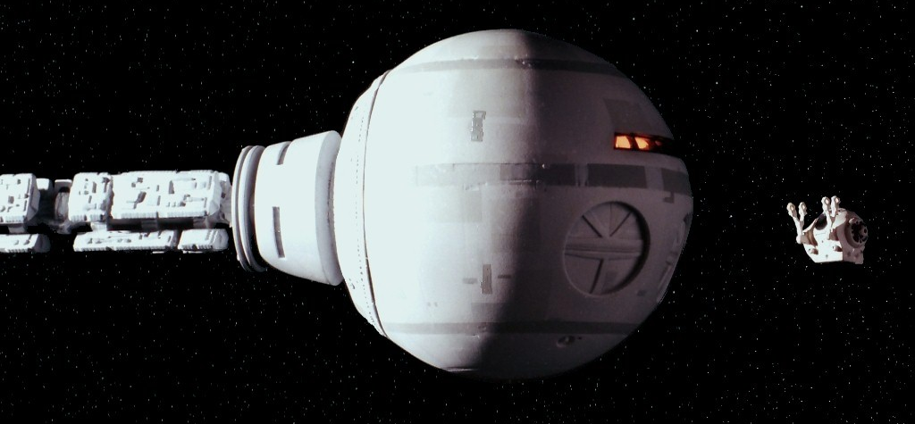
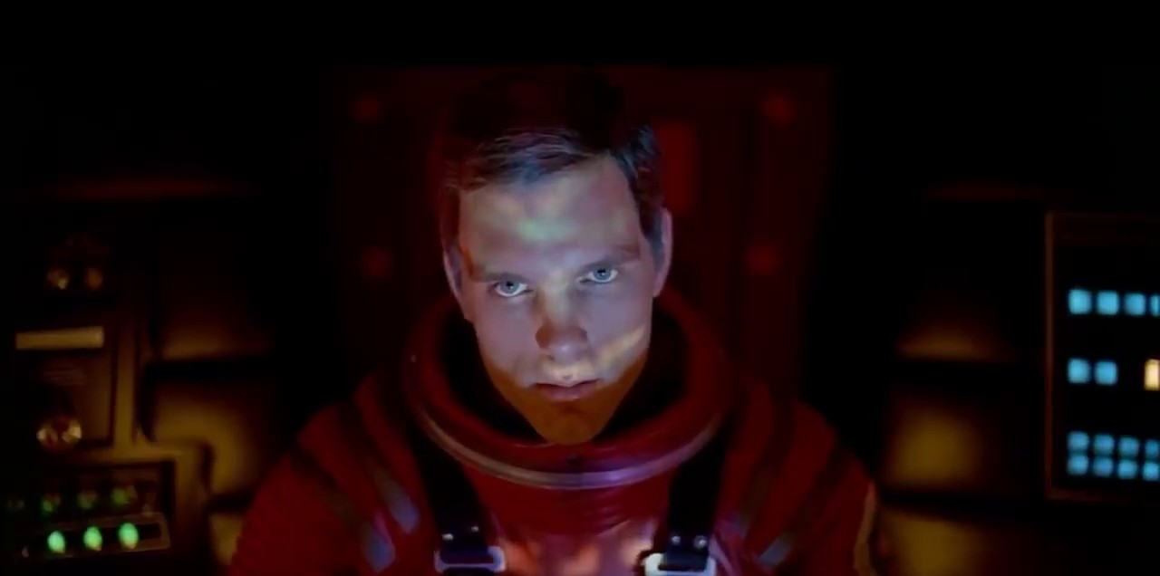
Pragmatic
knowledge of the relationship of meaning to the goals & intentions of the speaker
Syntax: Mono relation between linguistic forms (lexeme)
Semantic: Dyadic relation between lexemes and real-world entities
Pragmatic: Triadic relation between lexemes, world, and the user
Directive: HAL, open the pod bay door.

Slide 35
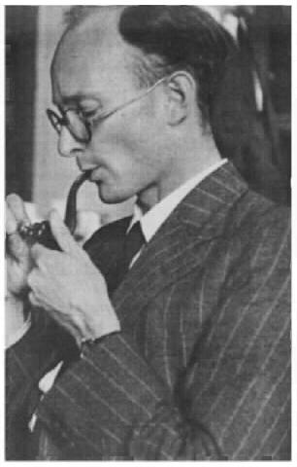
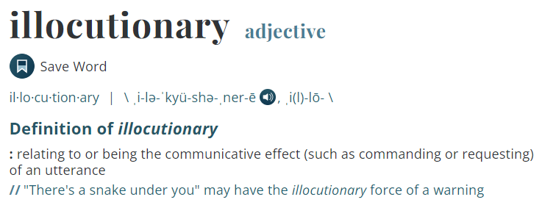
Pragmatic
knowledge of the relationship of meaning to the goals & intentions of the speaker
Illocutionary act was introduced into linguistics by the philosopher John Langshaw Austin in his investigation of the various aspects of speech acts.
Locution: what was said
"Is there any salt?" at the dinner table, a question about the presence of salt
Illocution: what was meant
"please give me some salt“ vs. “Yes” or “No”
Perlocution: what happened as a result, the actual effect.
to cause somebody to pass the salt.

Slide 36
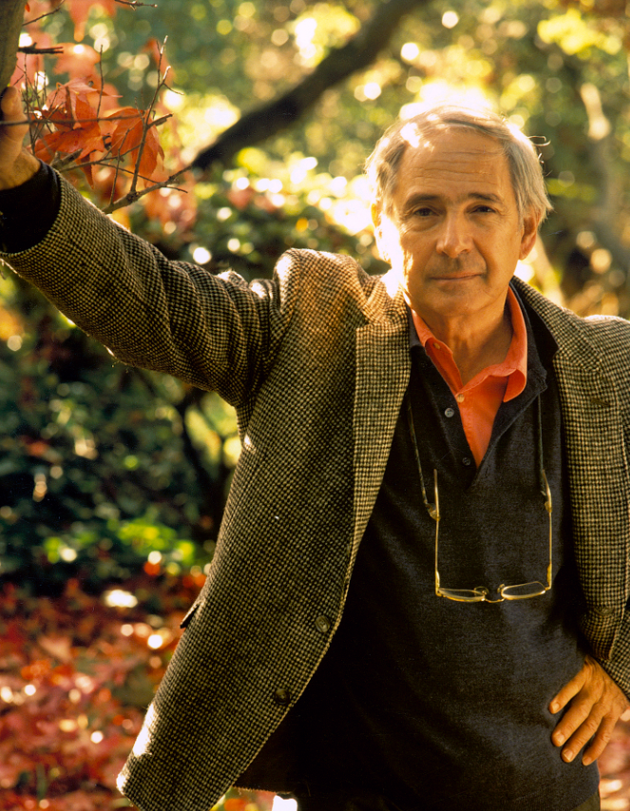
Pragmatic
knowledge of the relationship of meaning to the goals & intentions of the speaker
John Rogers Searle (/sɜːrl/; born July 31, 1932) is an American philosopher.
Searle, John R. “A Classification of Illocutionary Acts.” Language in Society, vol. 5, no. 1, Cambridge University Press, 1976, pp. 1–23, http://www.jstor.org/stable/4166848.
Representative (Assertive) committing the speaker to the truth of the expressed proposition, e.g., asserting, concluding
Directive attempts by the speaker to get the addressee to do something, e.g., advising, requesting
Commissive committing the speaker to a future course of action, e.g., promising, threatening, offering
Expressive expressing a psychological state, e.g., thanking, apologizing, welcoming
Declarative effecting immediate changes in an institutional state of affairs, with extra-linguistic qualities, e.g., declaring war, christening

Slide 37
Natural Language Processing
Phonetics and Phonology, Morphology, Syntax, Semantics, Pragmatics, Discourse

Slide 38
Discourse
knowledge about linguistic units larger than a single utterance
[discourse structure]
logical flow of events, states, propositions that makes for a coherent idea, argument, or story
another kind of pragmatic knowledge but within a session of communication
Co-reference
I made her duck

Slide 39
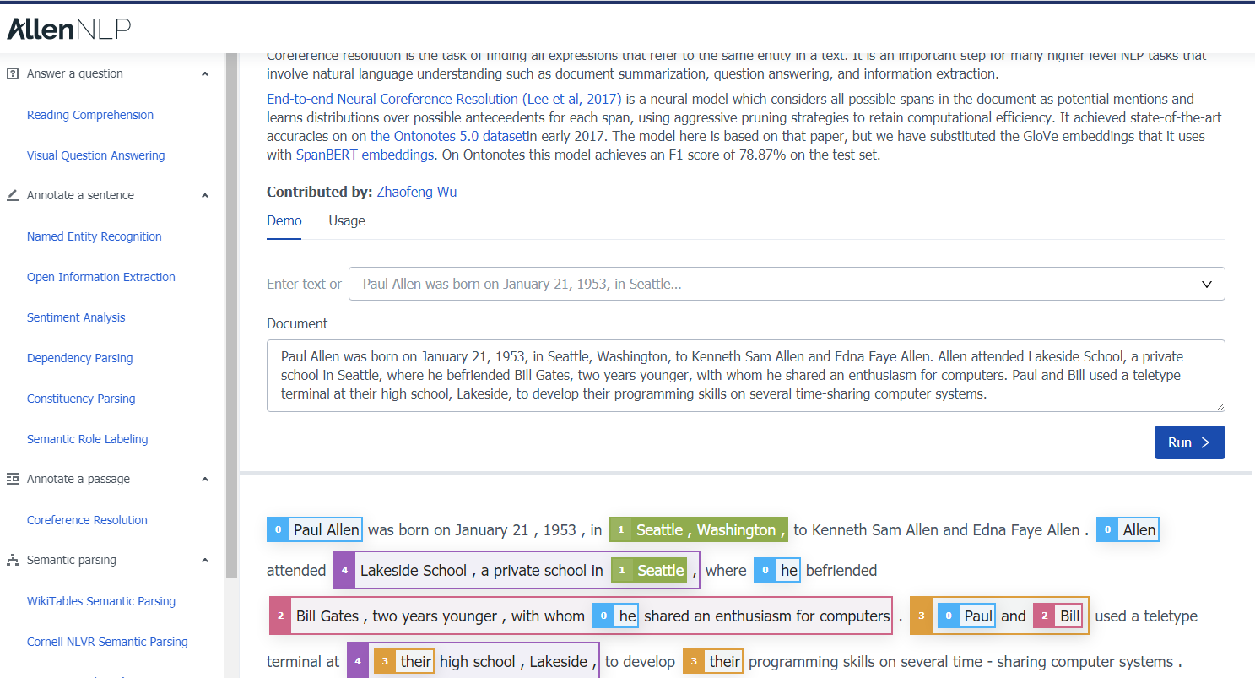
Notes:
https://demo.allennlp.org/coreference-resolution/MjYzNDkxMQ==

Slide 40
Discourse
knowledge about linguistic units larger than a single utterance
[discourse structure]
logical flow of events, states, propositions that makes for a coherent idea, argument, or story
another kind of pragmatic knowledge but within a session of communication
Discourse Relation
I refused to pay the cobbler the full $95 because he did poor work. (Contingency)
He knows a tasty meal when he eats one. (Temporal)
IBM’s stock price rose, but the overall market fell. (Comparison)
I never gamble too far; in particular, I quit after one try. (Expansion)

Slide 41
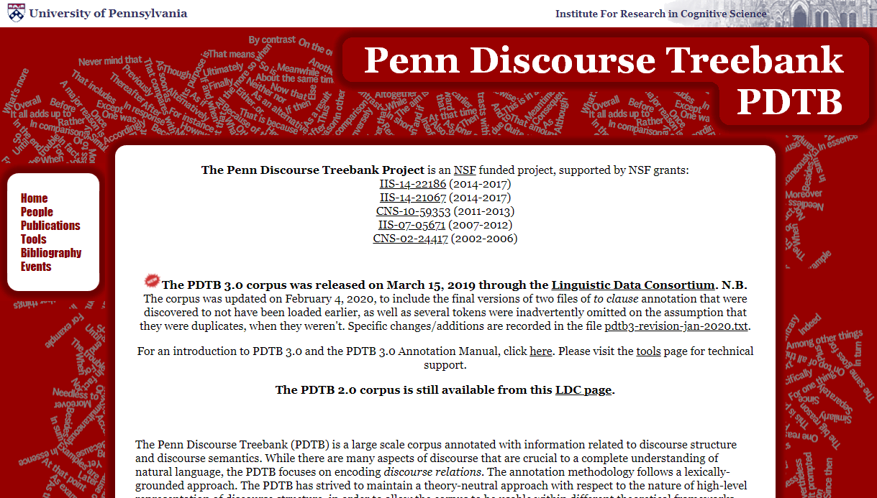

Slide 42
Discourse
due to background knowledge, linguistic elements are latent or implicit!
great movie by Stanley Kubrick

Slide 43
Let’s build an NLP model
Phonetics and Phonology, Morphology, Syntax, Semantics, Pragmatics, Discourse

Slide 44
Lec01B
01:00pm-02:20pm
Text Normalization

Slide 45
Text Segmentation
dividing text into linguistic units, such as words, sentences, or topics

Slide 46
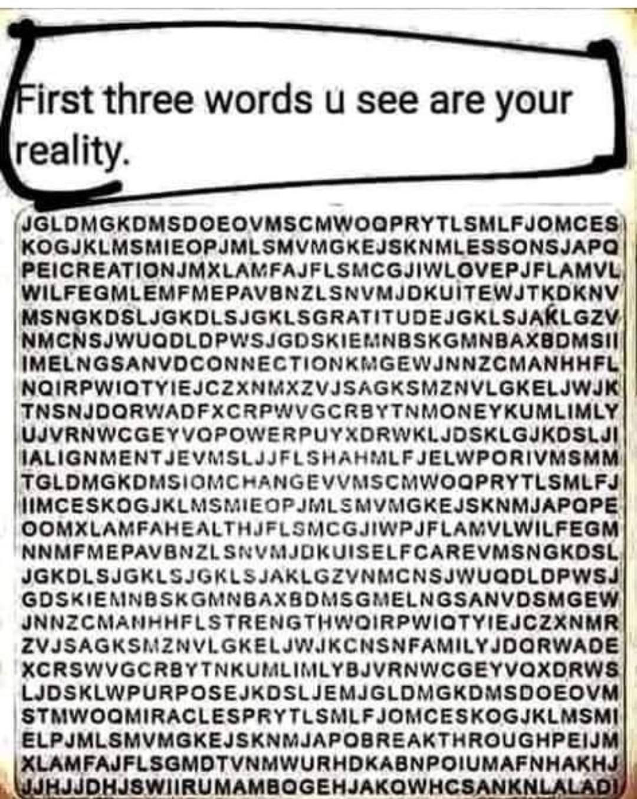

Slide 47
What should be considered as word?
Disfluencies in utterances
Fragments: broken-off repeated words: miss- misspelled, you- yourself
Fillers: non-lexical: huh, uh, erm, um, well, so, like, hmm
Punctuations , . : ; ? ! Special Chars $, /, …
part-of-speech tagging
parsing
speech synthesis
Morphemes:
smallest meaning-bearing unit of a language
‘unlikeliest’ : morphemes [un-], [likely], [-est]
Notes:
https://en.wikipedia.org/wiki/Speech_disfluency
https://www.nltk.org/api/nltk.tokenize.html

Slide 48
Word Segmentation → Tokenization
Word Boundary: Whitespace (natural word delimiter)
Split()
Exceptions
New York, rock ’n’ roll
Contractions: I’m
Languages: Japanese | Chinese | Thai don’t have spaces between words
Emoticons: :)
Hashtags: #nlproc.
Notes:
Lattice-Based Recurrent Neural Network Encoders for Neural Machine Translation

Slide 49
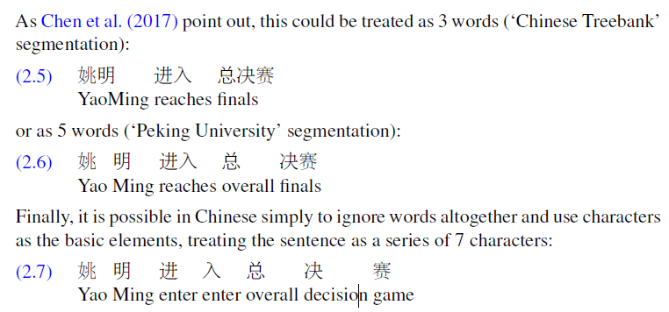
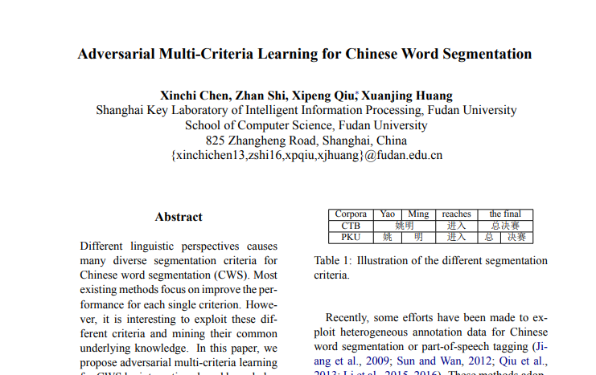
Chen, X., Shi, Z., Qiu, X., and Huang, X. (2017). Adversarial multi-criteria learning for Chinese word segmentation. In ACL 2017, 1193–1203.
Notes:
https://en.wikipedia.org/wiki/Speech_disfluency
https://www.nltk.org/api/nltk.tokenize.html

Slide 50
characters are at a reasonable semantic level for most applications
take characters as words!
Not for Japanese and Thai!
Chen, X., Shi, Z., Qiu, X., and Huang, X. (2017). Adversarial multi-criteria learning for Chinese word segmentation. In ACL 2017, 1193–1203.
Notes:
https://en.wikipedia.org/wiki/Speech_disfluency
https://www.nltk.org/api/nltk.tokenize.html

Slide 51
Word Boundaries → Space
Regular Expressions (RE): Finite State Automata
Alphabetical: [a-zA-Z]*
Alpha-numerical: [a-zA-Z0-9]*
Punctuations: Ph.D., AT&T, cap’n
Special Chars
Currency $45.55
Dates (01/02/06)
URLs http://www.stanford.edu
Twitter hashtags #nlproc
Email hfani@uwindsor.ca
Notes:
https://en.wikipedia.org/wiki/Speech_disfluency

Slide 52
Learn to Tokenize

Slide 53
Learn to Tokenize
Word→ Subword → Word
Byte-Pair Encoding (BPE)
Sennrich, et al., (2016). Neural machine translation of rare words with subword units. In ACL 2016.
Wordpiece
Wu et al. (2016) Google's neural machine translation system: Bridging the gap between human and machine translation." arXiv.
MaxMatch in BERT
Devlin et al. (2019). BERT: Pretraining of deep bidirectional transformers for language understanding. In NAACL HLT.
SentencePiece
Kudo, T. and Richardson, J. (2018). SentencePiece: A simple and language independent subword tokenizer and detokenizer for neural text processing. In EMNLP.

Slide 54
Learn to Tokenize
Byte-Pair Encoding (BPE) : Data Compression
Gage, P. (1994). A new algorithm for data compression. The C Users Journal, 12(2), 23–38.
aaabdaaabac → pair ‘aa’ occurs most often → replace it with a char (byte) that is not used ‘Z’
aaabdaaabac → ZabdZabac; Z=aa
aaabdaaabac

Slide 55
Learn to Tokenize
Byte-Pair Encoding (BPE) : Data Compression
Gage, P. (1994). A new algorithm for data compression. The C Users Journal, 12(2), 23–38.
aaabdaaabac → pair ‘aa’ occurs most often → replace it with a char (byte) that is not used ‘Z’
aaabdaaabac → ZabdZabac; Z=aa
aaabdaaabac → ZabdZabac → pair ‘ab’ occurs most often → replace it with ‘Y’
aaabdaaabac → ZabdZabac → ZYdZYac; Y=ab, Z=aa
aaabdaaabac → ZabdZabac

Slide 56
Learn to Tokenize
Byte-Pair Encoding (BPE) : Data Compression
Gage, P. (1994). A new algorithm for data compression. The C Users Journal, 12(2), 23–38.
aaabdaaabac → pair ‘aa’ occurs most often → replace it with a char (byte) that is not used ‘Z’
aaabdaaabac → ZabdZabac; Z=aa
aaabdaaabac → ZabdZabac → pair ‘ab’ occurs most often → replace it with ‘Y’
aaabdaaabac → ZabdZabac → ZYdZYac; Y=ab, Z=aa
aaabdaaabac → ZabdZabac → ZYdZYac → byte pair ‘ZY’ with ‘X’
aaabdaaabac → ZabdZabac → ZYdZYac → XdXac; X=ZY, Y=ab, Z=aa

Slide 57
Learn to Tokenize
Byte-Pair Encoding (BPE) : Data Compression
Gage, P. (1994). A new algorithm for data compression. The C Users Journal, 12(2), 23–38.
aaabdaaabac → pair ‘aa’ occurs most often → replace it with a char (byte) that is not used ‘Z’
aaabdaaabac → ZabdZabac; Z=aa
aaabdaaabac → ZabdZabac → pair ‘ab’ occurs most often → replace it with ‘Y’
aaabdaaabac → ZabdZabac → ZYdZYac; Y=ab, Z=aa
aaabdaaabac → ZabdZabac → ZYdZYac → byte pair ‘ZY’ with ‘X’
aaabdaaabac → ZabdZabac → ZYdZYac → XdXac; X=ZY, Y=ab, Z=aa
no pairs of bytes that occur more than 1 → no more compression

Slide 58
Learn to Tokenize
Byte-Pair Encoding (BPE) : Train
Dictionary⁽⁰⁾ | Vocabulary⁽⁰⁾ | get_stats() | most frequent pair
'l o w </w>' 'l o w e r </w>' 'n e w e s t </w>' 'w i d e s t </w>’ 'e s t e r </w>' | l o w e r t n s d </w> | (l, l) → 0 (l, o) → 2 (l, w) → 0 …. [all pairs of ‘l’ with others] (o, I) → 0 (o, o) → 0 …. [all pairs of ‘o’ with others] (e, s) → 3 …. [all pairs of ‘e’ with others] (o, </w>) → 0 …. | (e, s)

Slide 59
Learn to Tokenize
Byte-Pair Encoding (BPE) : Train
Dictionary⁽¹⁾ | Vocabulary⁽¹⁾ | get_stats() | most frequent pair
'l o w </w>' 'l o w e r </w>' 'n e w es t </w>' 'w i d es t </w>’ 'es t e r </w>' | l o w e r t n s d </w> es | (l, l) → 0 (l, o) → 2 (l, w) → 0 …. [all pairs of ‘l’ with others] (o, I) → 0 (o, o) → 0 …. [all pairs of ‘o’ with others] (e, s) → 3 → 0 …. [all pairs of ‘e’ with others] (o, </w>) → 0 …. (es, l) → 0 …. [all pairs of ‘es’ with others] (es, t) → 3 | (e, s) → (es, t)

Slide 60
Learn to Tokenize
Byte-Pair Encoding (BPE) : Train
Dictionary⁽²⁾ | Vocabulary⁽²⁾ | get_stats() | most frequent pair
'l o w </w>' 'l o w e r </w>' 'n e w est </w>' 'w i d est </w>’ ‘est e r </w>' | l o w e r t n s d </w> es est | (l, l) → 0 (l, o) → 2 …. (es, l) → 0 …. [all pairs of ‘es’ with others] (es, t) → 0 (est, l) → 0 ….[all pairs of ‘est’ with others] (est, </w>) → 2 | (es, t) → ?

Slide 61
Learn to Tokenize
Byte-Pair Encoding (BPE) : Train
Dictionary^{(n)} | Vocabulary^{(n)} | get_stats() | most frequent pair
'low</w>' 'lower</w>' 'newest</w>' 'widest</w>’ ‘ester</w>' | l,o,w,e,r,t,n,s,d,</w>,es est lo low, … newer wider | … | …

Slide 62
Learn to Tokenize
Byte-Pair Encoding (BPE) : Test
Vocabulary^{(n)}
l o w e r t n s d </w> es est lo low … newer wider ….
Input
… l o w es t p a r t o f t h e n e w e r h o u s e …. … l o w est p a r t o f t h e n e w e r h o u s e …. … lo w est p a r t o f t h e n e w e r h o u s e …. … low est p a r t o f t h e n e w e r h o u s e …. … low est p a r t o f t h e ne w e r h o u s e …. … low est p a r t o f t h e new e r h o u s e …. … low est p a r t o f t h e new er h o u s e …. … low est p a r t o f t h e newer h o u s e ….

Slide 63
Learn to Tokenize
Byte-Pair Encoding (BPE) : Test
Vocabulary^{(n)}
l o w e r t n s d </w> es est lo low … newer wider ….
Input
… l o w es t p a r t o f t h e n e w e r h o u s e …. … l o w est p a r t o f t h e n e w e r h o u s e …. … lo w est p a r t o f t h e n e w e r h o u s e …. … low est p a r t o f t h e n e w e r h o u s e …. … low est p a r t o f t h e ne w e r h o u s e …. … low est p a r t o f t h e new e r h o u s e …. … low est p a r t o f t h e new er h o u s e …. … low est p a r t o f t h e newer h o u s e ….
What if `lowest` is not built during training?

Slide 64

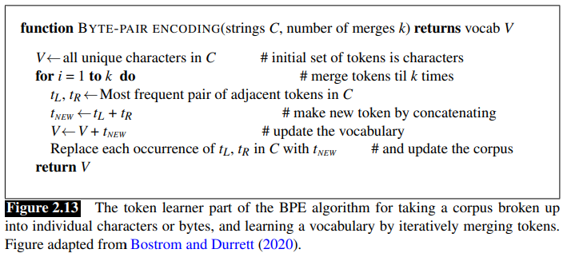
Learn to Tokenize
Byte-Pair Encoding (BPE)
1. Help to generalize to produce unseen words
2. Rare words into subword units is sufficient for translation
100 rare tokens in German training data and they are translatable from English via smaller units!
https://github.com/rsennrich/subword-nmt
Notes:
Bostrom, K. and G. Durrett. 2020. Byte pair encoding is suboptimal for language model pretraining. Findings of EMNLP.

Slide 65
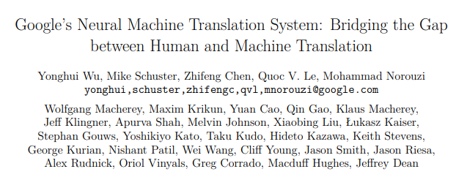
Learn to Tokenize
Wordpiece
Same as BPE but:
Merging the pairs that minimizes language model likelihood of the training data.
</w> appears at the beginning of words
Notes:
Bostrom, K. and G. Durrett. 2020. Byte pair encoding is suboptimal for language model pretraining. Findings of EMNLP.

Slide 66
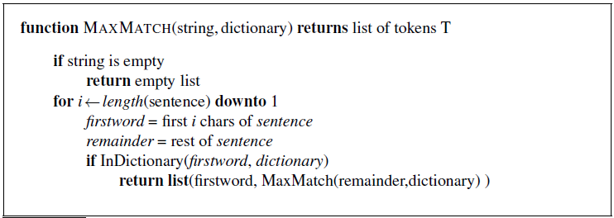
Learn to Tokenize
MaxMatch in BERT
Devlin et al. (2019). BERT: Pretraining of deep bidirectional transformers for language understanding. In NAACL HLT.
Notes:
Bostrom, K. and G. Durrett. 2020. Byte pair encoding is suboptimal for language model pretraining. Findings of EMNLP.

Slide 67
Learn to Tokenize
MaxMatch in BERT
Devlin et al. (2019). BERT: Pretraining of deep bidirectional transformers for language understanding. In NAACL HLT.
unaffable
[u][naffable]
[un][affable]
[una][ffable]
[unaf][fable]
[unaff][able]
[unaffa][ble]
[unaffab][le]
[unaffabl][e]
[unaffable]
Notes:
Bostrom, K. and G. Durrett. 2020. Byte pair encoding is suboptimal for language model pretraining. Findings of EMNLP.

Slide 68
Learn to Tokenize
MaxMatch in BERT
Devlin et al. (2019). BERT: Pretraining of deep bidirectional transformers for language understanding. In NAACL HLT.
unaffable
[u][naffable] return
[un][affable]
[una][ffable]
[unaf][fable]
[unaff][able]
[unaffa][ble]
[unaffab][le]
[unaffabl][e]
[unaffable]
Notes:
Bostrom, K. and G. Durrett. 2020. Byte pair encoding is suboptimal for language model pretraining. Findings of EMNLP.

Slide 69
Learn to Tokenize
MaxMatch in BERT
Devlin et al. (2019). BERT: Pretraining of deep bidirectional transformers for language understanding. In NAACL HLT.
unaffable
[u][naffable] return
[un][affable]
{‘un’} U [affable]
[a][ffable]
[af][fable]
[aff][able]
…
[una][ffable]
[unaf][fable]
[unaff][able]
[unaffa][ble]
[unaffab][le]
[unaffabl][e]
[unaffable]
Notes:
Bostrom, K. and G. Durrett. 2020. Byte pair encoding is suboptimal for language model pretraining. Findings of EMNLP.

Slide 70
Learn to Tokenize
MaxMatch in BERT
Devlin et al. (2019). BERT: Pretraining of deep bidirectional transformers for language understanding. In NAACL HLT.
unaffable → [un, ##aff, ##able]
intention → [intent, ##ion]
unwanted running → [un, ##want, ##ed, runn, ##ing]
## → marking as internal subwords that do not start words
Notes:
Bostrom, K. and G. Durrett. 2020. Byte pair encoding is suboptimal for language model pretraining. Findings of EMNLP.

Slide 71
Learn to Tokenize
Unsupervised or Weakly Supervised (Dictionary)
Search
Corpus
Dictionary
Notes:
Bostrom, K. and G. Durrett. 2020. Byte pair encoding is suboptimal for language model pretraining. Findings of EMNLP.

Slide 72
Learn to Tokenize
Supervised
Corpus
+
Label
Sentence | Word Boundary by Oracle
i_am_sorry. | [0,0], [2,3], [5,9]
open_the_door | [0,3], [5,7], [9, 12]
hello_world! | [0,4], [6, 10]
great_news,_mary! | [0, 4], [6, 9], [12, 15]
Notes:
Bostrom, K. and G. Durrett. 2020. Byte pair encoding is suboptimal for language model pretraining. Findings of EMNLP.

Slide 73
Learn to Tokenize
Supervised (Boolean Classifier) : Train
Corpus
+
Label
Sentence | Word Boundary by Oracle
I_ | 0 SEP
_a | 0 SEP
am | 1 APN
m_ | 0 SEP
_s | 1 APN
so | 1 APN
or | 1 APN
… | …
Sentence | Word Boundary by Oracle
I_am_sorry. | [0,0], [2,3], [5,9]
Open_the_door | [0,3], [5,7], [9, 12]
Hello_world! | [0,4], [6, 10]
Great_news,_Mary! | [0, 4], [6, 9], [12, 15]
f(x_{i}, x_{i+1}) → {0, 1}
Notes:
Bostrom, K. and G. Durrett. 2020. Byte pair encoding is suboptimal for language model pretraining. Findings of EMNLP.

Slide 74
Learn to Tokenize
Supervised (Boolean Classifier) : Test
Sentence | f(x_{i}, x_{i+1}) | Truth | Error
na | 1 APN | 1 APN | 0
at | 1 APN | 1 APN | 0
tu | 1 APN | 1 APN | 0
ur | 1 APN | 1 APN | 0
ra | 0 SEP | 1 APN | 1
al | 1 APN | 1 APN | 0
l_ | 1 APN | 0 SEP | 1
_l | 1 APN | 0 SEP | 1
la | 0 SEP | 1 APN | 1
…. | …. | ….
natural_language
[natur][al_l][anguage]
Notes:
Bostrom, K. and G. Durrett. 2020. Byte pair encoding is suboptimal for language model pretraining. Findings of EMNLP.

Slide 75
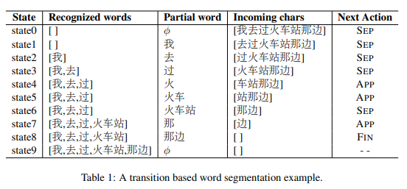
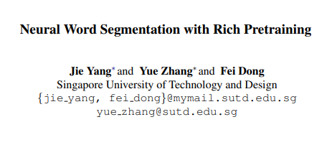
Learn to Tokenize
Supervised (Boolean Classifier)
Notes:
Bostrom, K. and G. Durrett. 2020. Byte pair encoding is suboptimal for language model pretraining. Findings of EMNLP.

Slide 76
Text Segmentation
dividing text into linguistic units, such as words, sentences, or topics

Slide 77
Sentence Segmentation
Rule-based: Regular Expression
Stanford’s CoreNLP
Combined by word segmentation (Tokenizer)
Notes:
Lattice-Based Recurrent Neural Network Encoders for Neural Machine Translation

Slide 78
Sentence Segmentation
Boundary markers
Exclamation (!)
Question (?)
Period (.)
Abbreviation: Mr. or Inc.
ABS Inc. hold a conference.
Both
The conference is in ABS Inc.
Notes:
Lattice-Based Recurrent Neural Network Encoders for Neural Machine Translation

Slide 79
Sentence Segmentation
Learn to Segment
Learn to label (.) as sentence marker or abbreviation marker or both
Notes:
Lattice-Based Recurrent Neural Network Encoders for Neural Machine Translation

Slide 80
heads up!

Slide 81
dost tha or ra- hega ... dont wory ... but dherya rakhe
[he was and will remain a friend ... don’t worry ... but have faith]
Newspaper, Fiction, non-Fiction, Academic, Social, Conversation → Disfluencies
Code Switch
Genre
Corpus
Dialect
Rationale
Time
Language changes over time
Oxford Dictionary has 273,000 headwords; 171,476 of them being in current use, 47,156 being obsolete words
Standard American English (SAE) vs. African American Vernacular English (AAVE)
iont: I don’t, talmebout: talking about
Author
Place
Age, Gender, Race, Socioeconomic

Slide 82
Corpus (plural Corpora)
Brown University
English, newspaper, fiction, non-fiction, academic, etc., 1963–64
#Documents = Size = 500, #Tokens = 1 M, #Vocab = Unique Tokens = Types = 38 K
Switchboard
American English, Telephone Conversations between strangers, Early 1990s
#Conversations = Size = 2430, #Tokens = 2.4 M, #Vocab = Unique Tokens = Types = 20 K
Google N-grams
English, Google Books
#Tokens = 1 G, #Vocab = Unique Tokens = Types = 13 M
Notes:
https://docs.google.com/document/d/14PWeoTkrnKk9H8_7CfVbdvuoFZ7jYivNTkBX2Hj7qLw/edit
http://www.nltk.org/nltk_data/

Slide 83
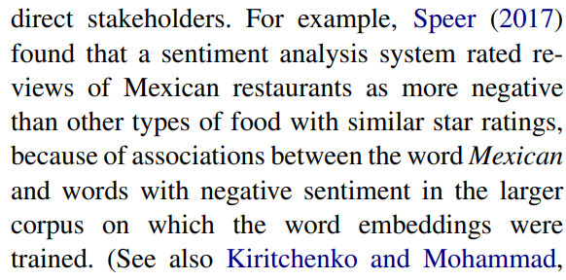
Datasheets (Data Statements) for Datasets
Emily M. Bender, Batya Friedman, ACL (2018)
Gebru, Timnit, et al. (2018)
Notes:
Data Statements for Natural Language Processing: Toward Mitigating System Bias and Enabling Better Science

Slide 84
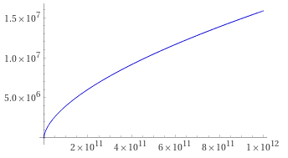

Herdan’s Law or Heaps’ Law
Herdan, G. (1960). Type-token mathematics. The Hague, Mouton.
Heaps, H. S. (1978). Information retrieval. Computational and theoretical aspects. Academic Press.
$\left|V\right|=kN^{β}$; 0 < $β$ < 1
$k$ and $β$are positive constants.
The value of $β$ depends on the corpus size and the genre, but at least for the large corpora $β$ ranges from 0.67 to 0.75.
Notes:
the vocabulary size for a text goes up significantly faster than the square root of its length in words

Slide 85
Text Normalization
putting tokens in a standard format
choosing a single normal form for tokens with multiple forms
USA → US
ain’t → am not

Slide 86
Text Normalization
Case Folding
mapping everything to lower (upper) case
Lemmatization
converts the word to its meaningful base form (lemma).
The same word may have multiple different Lemmas
Stemming
removes or stems the last few characters of a word
often leading to incorrect meanings and spelling
Autocorrection

Slide 87
Text Normalization
Case Folding
Positive Impact: ‘USA’ vs. ‘usa’
Information Retrieval, Speech Recognition
Negative Impact: ‘US’ the country vs. ‘us’ the pronoun
Sentiment Analysis, Text Classification, Information Extraction, Machine Translation

Slide 88
Text Normalization
Lemmatization
Polysemy
the association of one word with two or more distinct meanings
a polyseme is a word or phrase with multiple meanings
saw (noun) vs. saw (verb) → see

Slide 89
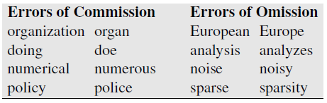
Text Normalization
Lemmatization : Stemming
crude, chopping off word-final stemming affixes
aim is not to produce a linguistic root, but to improve performance
Porter, M. F. (1980). An algorithm for suffix stripping. Program, 14(3), 130–137.
A commission error is an error made due to using an item in the wrong context.

Slide 90
Text Normalization
Spelling Correction
via
Minimum Edit Distance : Word Similarity (Distance)

Slide 91
Text Normalization
Spelling Correction
via
Minimum Edit Distance : Word Similarity in Surface

Slide 92
Text Normalization
Spelling Correction via Minimum Edit Distance
j
 | a | p | p | l | i | c | a | t | i | o | n
a
p
l
i
k
a
t
i
i
n
D(x[0:i], y[0:j]) = min{
D(x[0:i-1], y[0:j-1]) + x[i] ↔ y[j]
D(x[0:i], y[0:j-1]) + 1
D(x[0:i-1], y[0:j]) + 1
}
i
x[i] ≠ y[j] → 2
x[i] = y[j] → 0

Slide 93
Text Normalization
Spelling Correction via Minimum Edit Distance
j
 | a | p | p | l | i | c | a | t | i | o | n
a
p
l
i
k
a
t
i
i
n
D(x[0:i], y[0:j]) = min{
D(x[0:i-1], y[0:j-1]) + x[i] ↔ y[j]
D(x[0:i], y[0:j-1]) + 1
D(x[0:i-1], y[0:j]) + 1
}
i
Insert

Slide 94
Text Normalization
Spelling Correction via Minimum Edit Distance
j
 | a | p | p | l | i | c | a | t | i | o | n
a
p
l
i
k
a
t
i
i
n
D(x[0:i], y[0:j]) = min{
D(x[0:i-1], y[0:j-1]) + x[i] ↔ y[j]
D(x[0:i], y[0:j-1]) + 1
D(x[0:i-1], y[0:j]) + 1
}
i
Delete

Slide 95
Text Normalization
Spelling Correction via Minimum Edit Distance
j
 | a | p | p | l | i | c | a | t | i | o | n
a
p
l
i
k
a
t
i
i
n
D(x[0:i], y[0:j]) = min{
D(x[0:i-1], y[0:j-1]) + x[i] ↔ y[j]
D(x[0:i], y[0:j-1]) + 1
D(x[0:i-1], y[0:j]) + 1
}
i
Insert
Delete

Slide 96
Text Normalization
Spelling Correction via Minimum Edit Distance
m
 | a | p | p | l | i | c | a | t | i | o | n
a
p
l
i
k
a
t
i
i
n
D(x[0:i], y[0:j]) = min{
D(x[0:i-1], y[0:j-1]) + x[i] ↔ y[j]
D(x[0:i], y[0:j-1]) + 1
D(x[0:i-1], y[0:j]) + 1
}
Insert
Delete
n
D(x[0:n], y[0:m])

Slide 97
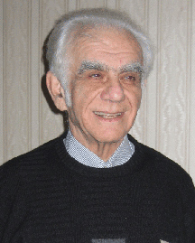
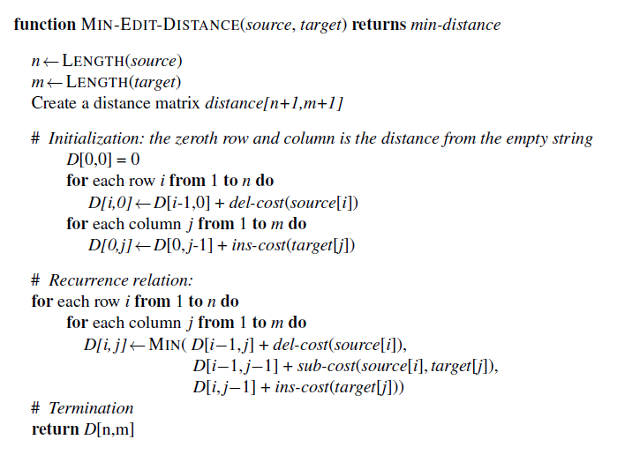
Text Normalization
Spelling Correction via Minimum Edit Distance
Levenshtein, V. I. (1966). Binary codes capable of correcting deletions, insertions, and reversals. Cybernetics and Control Theory (1965).
Pioneer in the theory of error correcting codes, Vladimir I. Levenshtein, known as the father of coding theory in Russia.

Slide 98
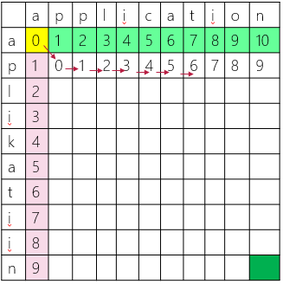
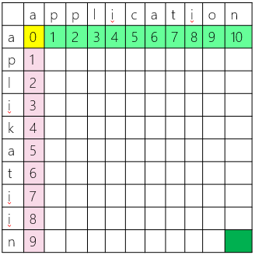
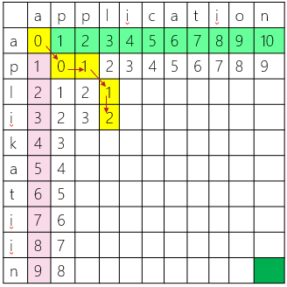

Text Normalization
Spelling Correction via Minimum Edit Distance
https://phiresky.github.io/levenshtein-demo/

Slide 99
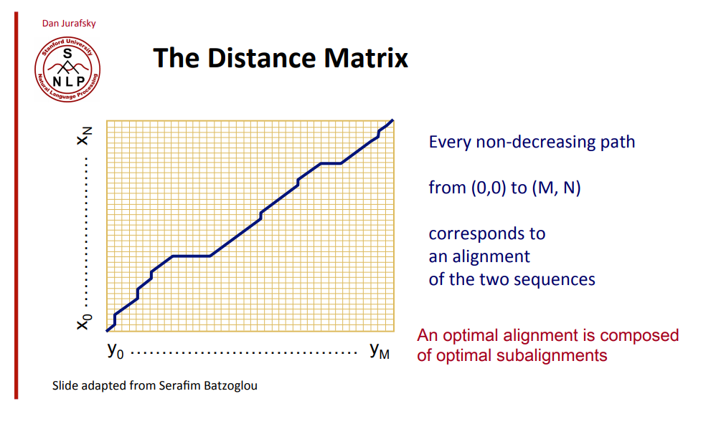
Text Normalization
Spelling Correction via Minimum Edit Distance

Slide 100
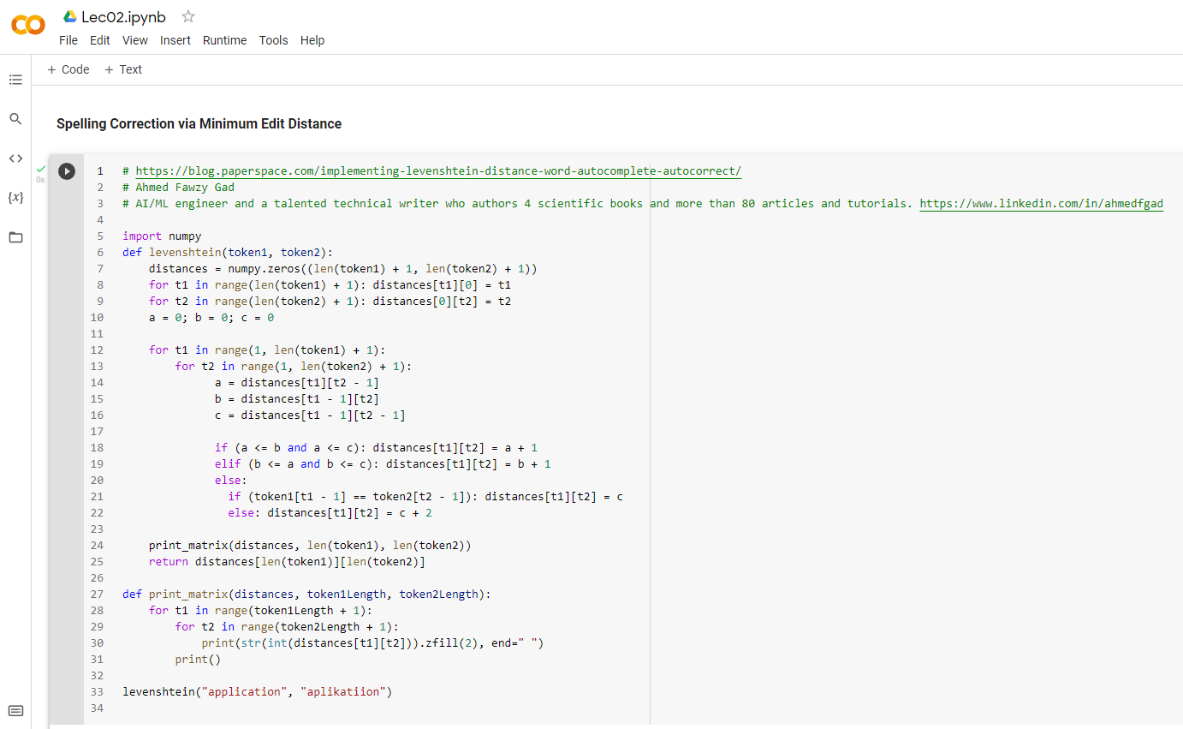

Slide 101

Text Normalization
Spelling Correction via Minimum Edit Distance
Levenshtein (1966)
Time Complexity: O($n×m$)
Space Complexity: O($n×m$)

Slide 102

Text Normalization
Learn to Correct Spellings
online texts (e.g., emails) depends on keyboards.
Misspells happens more on characters that sit next to each other on the keyboard.
Speed of typing is a source of error → Transposition: ‘Desing’ ‘Design’

Slide 103
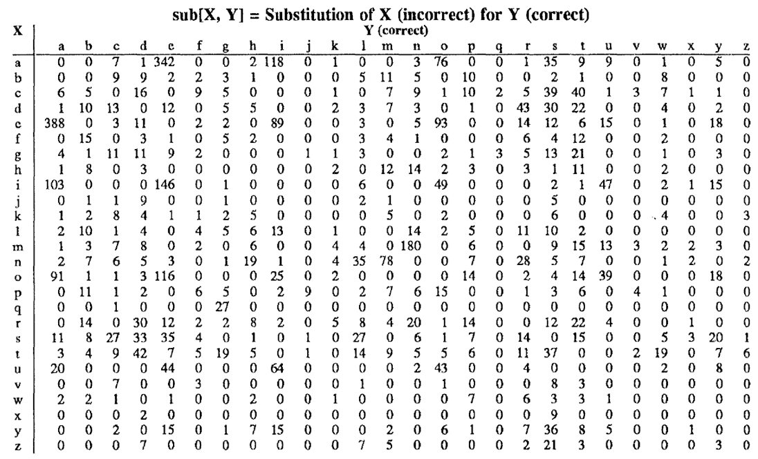
Text Normalization
Learn to Correct Spellings
Weighted Minimum Edit Distance

Slide 104
Text Normalization
Learn to Correct Spellings
Weighted Minimum Edit Distance
D(x[0:i], y[0:j]) = min{
D(x[0:i-1], y[0:j-1]) + x[i] ↔ y[j]
D(x[0:i], y[0:j-1]) + insert(y[j])
D(x[0:i-1], y[0:j]) + delete(x[i])
}
x[i] ≠ y[j] → sub(x[i], y[j])
x[i] = y[j] → 0

Slide 105
Text Normalization
Learn to Correct Spellings
Weighted Minimum Edit Distance
Applications
Finding the closest word from Dictionary as the correct spell (Autocorrection)
Finding the closest word from Dictionary as the correct meaning!?
Finding the closest word from Dictionary as the prediction!? (Autocompletion)
Computational Biology
Aligning two sequences of protein
Daniel Jurafsky: https://www.youtube.com/watch?v=IL0-bD_e8s4

